Slide 1

CDC Diabetes Prediction Based on Health Indicators
Luke Abbatessa & Rajendra Goparaju

Slide 2
Table of Contents
Background/How the Idea Came to Be Slide 3
Methodology - Data Cleaning/Preprocessing Slide 4
Methodology - Exploratory Data Analysis Slide 5
Methodology - Data Division/Model Selection Slide 6
Methodology - Feature Selection Slide 7
Methodology - Hyperparameter Tuning Slide 8
Results Slides 9-19
Future Work Slide 20

Slide 3
Background/How the Idea Came to Be
We were initially interested in a science-based, data science-focused project
After some discussion, we agreed upon a project focused on healthcare
After researching publicly accessible datasets in the UC Irvine Machine Learning Repository, we stumbled upon a dataset titled “CDC Diabetes Health Indicators”
We chose this dataset in particular because
-The dataset is only eight years old
-It consists of 253,680 instances (more data = stronger ML/DL models), each of which represents a person participating in a study (real data)
-Its creation was funded by the CDC, and it has no missing values (trustworthy)

Slide 4
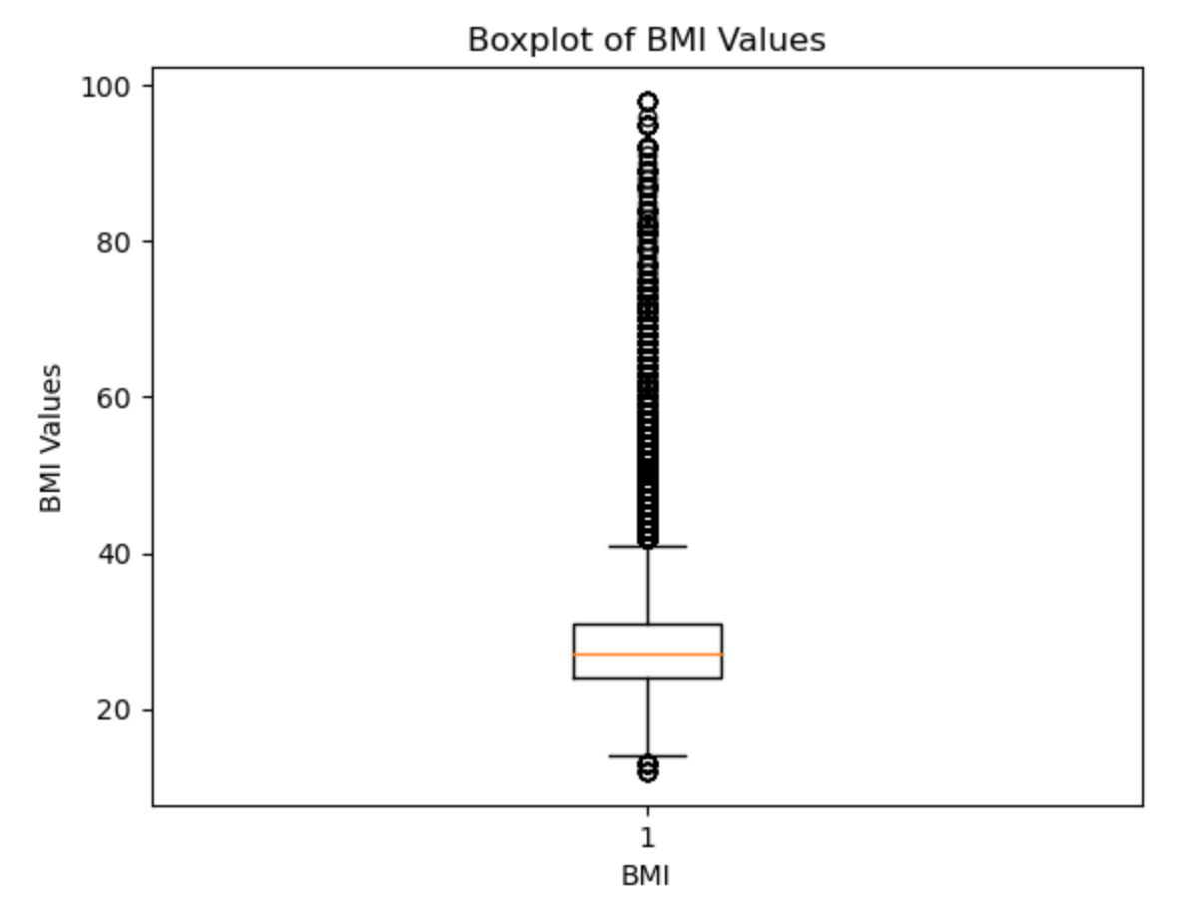
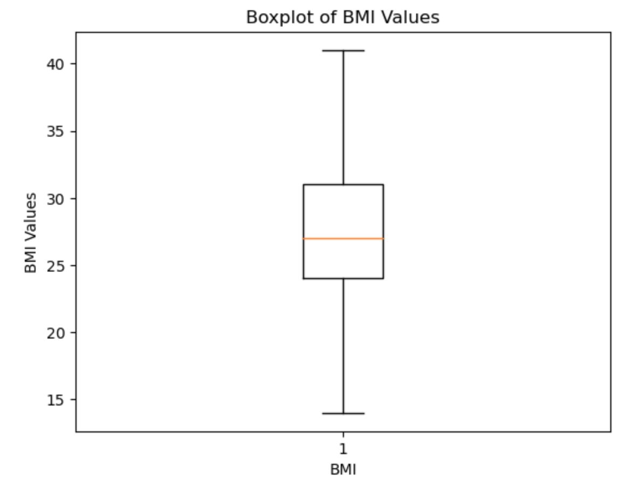
Methodology - Data Cleaning/Preprocessing
In an effort to clean the data, we:
Changed the variable data types from float-based to integer-based
Removed outliers from the variable “BMI” using the Interquartile Range (IQR) Method
Dropped duplicate rows from the Pandas DataFrame
Shuffled the data to eliminate the possibility of any biases, such as when calculating accuracy during model implementation
Standardized the non-binary features and dropped the non-standardized features from the dataframe
Before removing outliers from “BMI”
After removing outliers from “BMI”

Slide 5
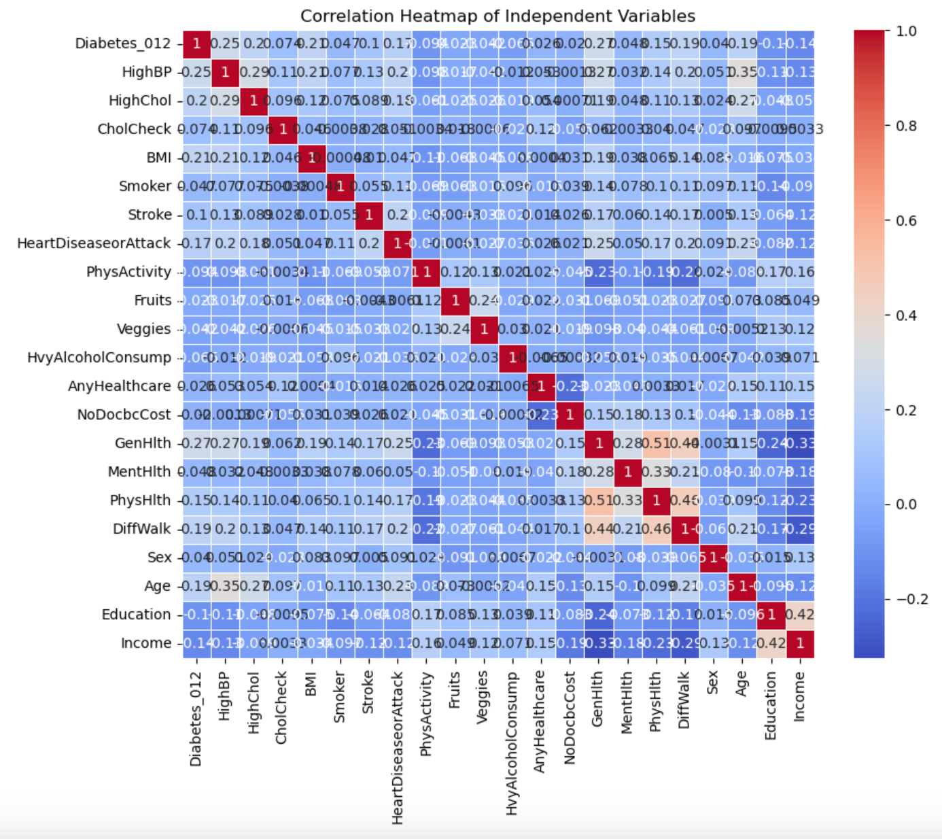
Methodology - Exploratory Data Analysis
We plotted a correlation heatmap to determine the correlations between the features present in the dataset
Since the highest correlation coefficient between two independent variables was 0.51 (considerably weak positive correlation), no independent variables were confounded, thus we kept all features for ML/DL model development

Slide 6
Methodology - Data Division/Model Selection
Data Division
Once we isolated the features (X) from the target (y), we performed a train-test split on the data, allocating 70% of the data for training and the remaining 30% for testing
We followed up the train-test split by performing another split on the testing data, allocating 50% of the data for validation and the remaining 50% for testing
For each of the ten different models we implemented, we predicted the target variable both for the cross-validation dataset as a baseline and for the test dataset as a final result
This data division was repeated over two iterations (once when working with all the features, a second time after feature selection was implemented)
Model Selection
In the beginning, we chose SciKit-Learn’s Decision Tree Classifier, SciKit-Learn’s Random Forest Classifier, Keras’ Neural Networks Classifier, and the XGBoost Classifier because we were familiar with all four of these models prior and knew they were all capable of multi-class classification
As the project went on, we decided to forego the Decision Tree Classifier because the Random Forest Classifier produced better metrics

Slide 7
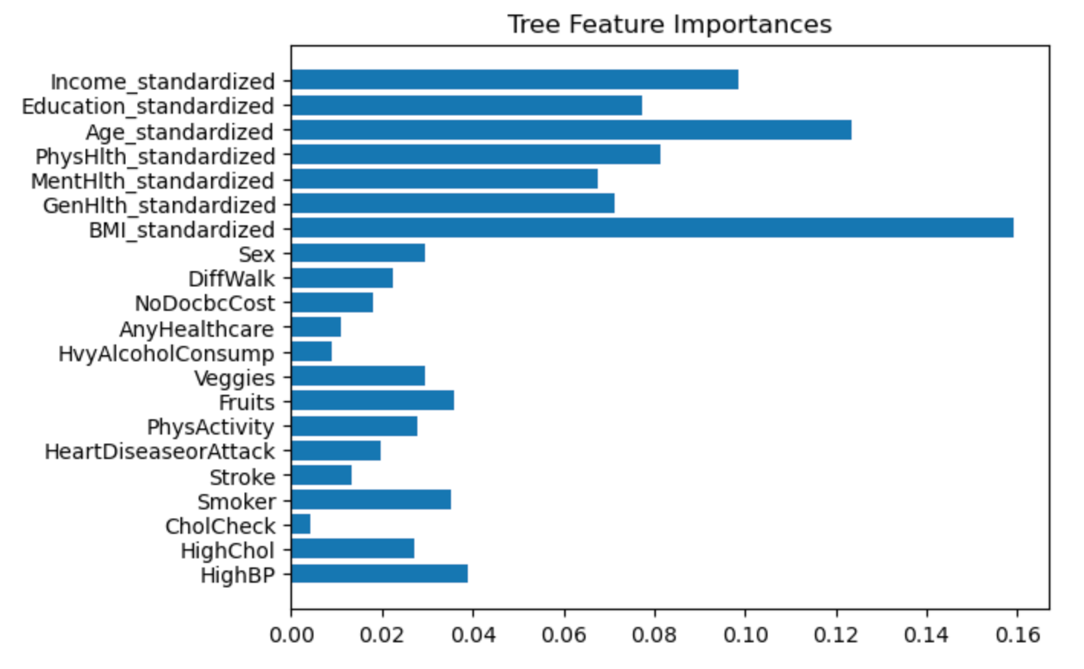
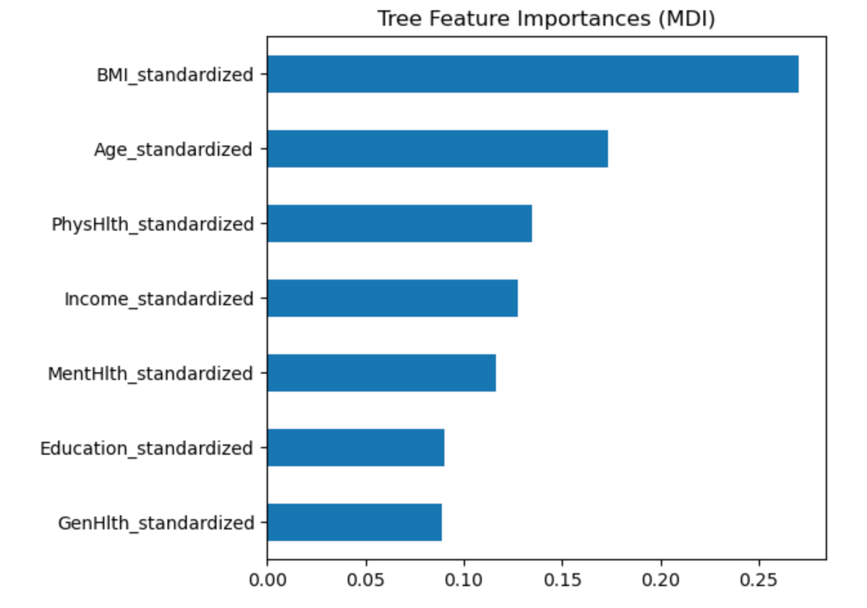
Methodology - Feature Selection
We implemented two techniques, both with the use of SciKit-Learn’s ExtraTreesClassifier:
Tree-based feature selection
Feature selection as part of a pipeline/tree’s feature importance from Mean Decrease in Impurity (MDI)
Both techniques informed us of the same most important features: ‘BMI_standardized’, ‘GenHlth_standardized’, ‘MentHlth_standardized’, ‘PhysHlth_standardized’, ‘Age_standardized’, ‘Education_standardized’, and ‘Income_standardized’
Tree-based feature selection
Feature selection as part of a pipeline/tree’s feature importance from Mean Decrease in Impurity (MDI)

Slide 8
Methodology - Hyperparameter Tuning
We used GridSearchCV to perform hyperparameter tuning for the Random Forest Classifier, Neural Networks Classifier, and the XGBoost Classifier
Random Forest Classifier
“n_estimators” (The number of trees in the forest): 50
“criterion” (The function used to measure the quality of a split): “gini”
“max_depth” (The maximum depth of the individual trees in the forest): 10
“min_samples_split” (The minimum number of samples required to split an internal node): 5
Neural Networks Classifier
“units” (The number of neurons in a particular layer): 32
“learning_rate” (Controls the size of the steps taken during the optimization process): 0.001
“batch_size” (The number of training examples used in one iteration): 32
“epochs” (Number of times the learning algorithm will work through the entire training dataset): 10
“optimizer” (An algorithm that adjusts the model’s weights during training to minimize the loss function): “adam”
“activation” (A function that allows the neural network to learn complex patterns): “sigmoid”
XGBoost Classifier
“learning_rate”: 0.1
“n_estimators”: 100
“max_depth”: 5
“min_child_weight” (Minimum sum of instance weight needed in a child): 1
“subsample” (Fraction of samples used for fitting the individual base learners): 1.0
“colsample_bytree” (Fraction of features used for fitting the individual base learners): 1.0
“gamma” (Minimum loss reduction required to make a further partition on a leaf node): 0.1

Slide 9
Results
SciKit-Learn’s Decision Tree Classifier (all features)

Slide 10
Results (cont.d)
SciKit-Learn’s Random Forest Classifier (all features)

Slide 11
Results (cont.d)
Keras’ Neural Networks Classifier (all features)

Slide 12
Results (cont.d)
XGBoost Classifier (all features)

Slide 13
Results (cont.d)
SciKit-Learn’s Random Forest Classifier (selected features)

Slide 14
Results (cont.d)
Keras’ Neural Networks Classifier (selected features)

Slide 15
Results (cont.d)
XGBoost Classifier (selected features)

Slide 16
Results (cont.d)
SciKit-Learn’s Random Forest Classifier (all features and optimal hyperparameters)

Slide 17
Results (cont.d)
Keras’ Neural Networks Classifier (all features and optimal hyperparameters)

Slide 18
Results (cont.d)
XGBoost Classifier (all features and optimal hyperparameters)

Slide 19
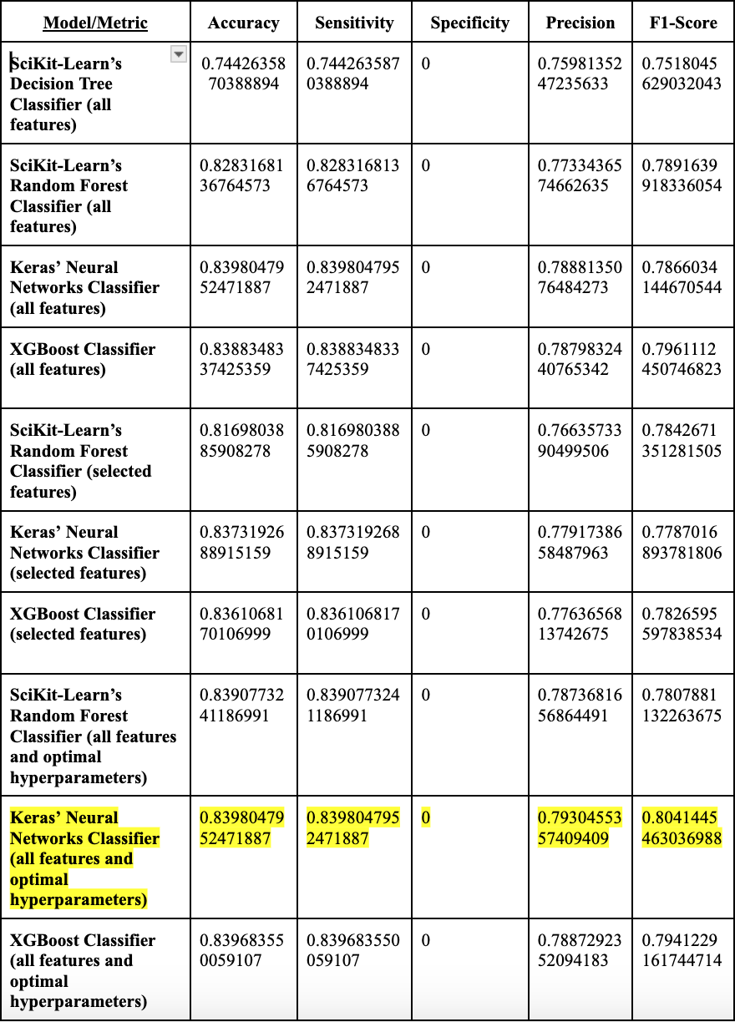
Results (cont.d)
***Keras’ Neural Networks Classifier (all features and optimal hyperparameters) proved to be the best model at predicting whether someone was diabetic, pre-diabetic, or healthy based on health indicators***

Slide 20
Future Work
If we were to do anything differently, we would:
Consider using a graphics processing unit (GPU) to perform more in-depth hyperparameter tuning and/or train the models quicker
Consider incorporating self-developed models to compare against SciKit-Learn and Keras’ counterparts, in addition to XGBoost
Consider incorporating our own hyperparameter tuning to compare against GridSearchCV

